Slide 1


CMR TECHNICAL CAMPUS UGC AUTONOMOUS (Accredited by NAAC, NBA, Permanently Affiliated to JNTUH, Approved by AICTE, New Delhi) Recognized Under Section 2(f) & 12(B) of the UGC Act.1956, Kandlakoya (V), Medchal Road, Hyderabad-501401 . DEPARTMENT OF COMPUTER SCIENCE AND ENGINEERING
A
Major Project
On
Improving Shopping Mall Revenue by Real Time Customized Digital Coupon Issuance
SANIYA 217R1A0551 Under the Guidance of
THAGURAPU RAGHUVARAN 217R1A0557 Dr.V.Naresh kumar
ROUTHU HARSHA VARDHAN 217R1A0548 (Assoc.Professor, HoD CSE-II)

Slide 2
Table of Contents
Introduction
Existing System
Disadvantages
Proposed System
Advantages
Hardware Requirements
Software Requirements
Novelty of the Project
Architecture
Modules
UML Diagrams
Sample Code
Results
Conclusion
Future Scope
References
Github Link

Slide 3
INTRODUCTION
Customer churn management is one of the most important areas of marketing.
A method to prevent customer churn and increase purchase conversion rate by issuing customized discount coupons to customers with high churn rate based on big data in real time.
A two-dimensional cluster analysis-based churn rate estimation combined with a recommendation system was found to be significantly more useful than the respective simple models.

Slide 4
EXISTING SYSTEM
Among various customer segmentation techniques, RFM methods are the most classical yet universally utilized methods.
This constructs segments according to three dimensional classes.
The existing systems in shopping malls often rely on traditional marketing techniques such as static discounts, paper coupons, and generic promotions. These methods lack personalization and real-time relevance, leading to lower engagement and effectiveness.
Traditional coupons also face logistical challenges in distribution and redemption, making them less efficient in driving sales.

Slide 5
DISADVANTAGES
The complexity of data
Data availability
Incorrect labeling

Slide 6
PROPOSED SYSTEM
Applying deep learning techniques to real-time click stream data, we find customers with high chance of churning rates and issue a coupon that suits customers.
Generated RNN-based churn estimation models for each customer segment resulted from two-dimensional customer segmentation. After that, we issued customized product category coupons to customers who are at high risk of churn. Hybrid recommendation system is utilized for customized coupon issuance.

Slide 7
ADVANTAGES
Sustainability
Increased Foot Traffic
Boost in Sales and Revenue
Enhanced Customer Loyalty

Slide 8
HARDWARE REQUIREMENTS
Processor - Pentium –IV
RAM - 4GB (min)
Hard Disk - 20 GB

Slide 9
SOFTWARE REQUIREMENTS
Operating system : Windows 7 Ultimate or Later
➢Coding Language : Python.
➢Front-End : Python.
➢Back-End : Django-ORM
➢Designing : HTML, CSS, java script.
➢Data Base : MySQL (WAMP Server).

Slide 10
NOVELTY OF THE PROJECT
The Collaborative filtering recommendation algorithm is suitable for customers who tend to accept other people’s opinions because it is an algorithm that recommends products purchased by neighbors or similar customers.
On the other hand, content based recommendation algorithms are suitable for customers with strong unique characteristics because they continue to recommend products similar to their past purchases.

Slide 11
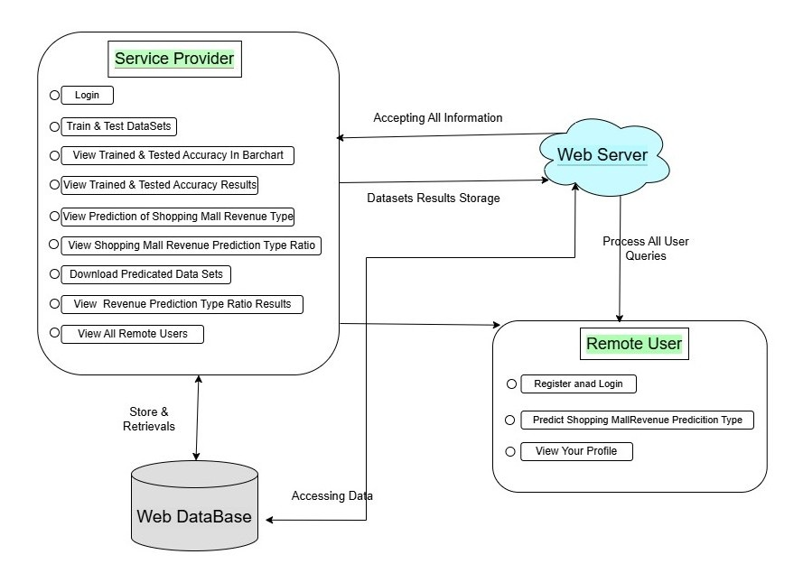
ARCHITECTURE

Slide 12
MODULES
Service Provider:
Logs in with a valid username and password to access the system.
Performs operations like training/testing datasets, viewing accuracy results, predicting shopping mall revenue, and managing users.
View and Authorize Users:
Admin views the list of registered users along with their details.
Admin authorizes users for system access.
Remote User:
Users must register and log in before performing any operations.
After logging in, users can predict shopping mall revenue and view their profiles.

Slide 13
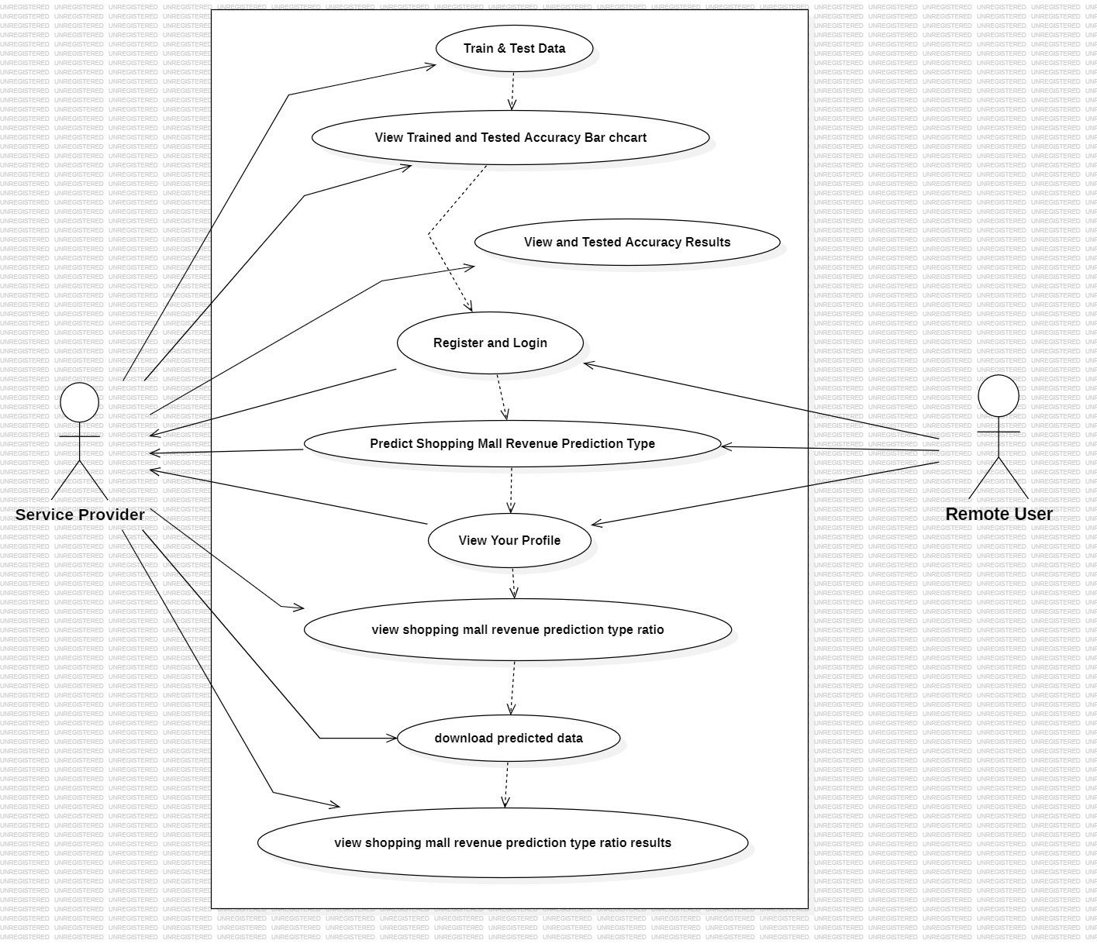
UML DIAGRAMS
Use-Case Diagram:

Slide 14
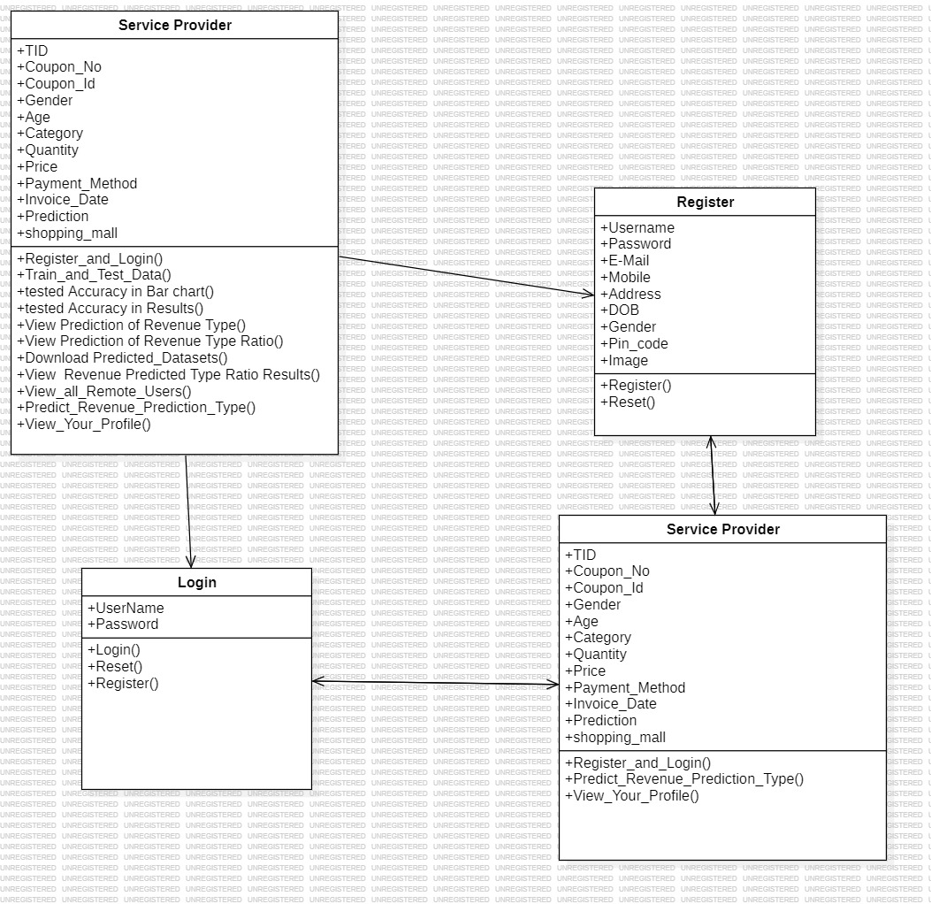
Class Diagram:

Slide 15
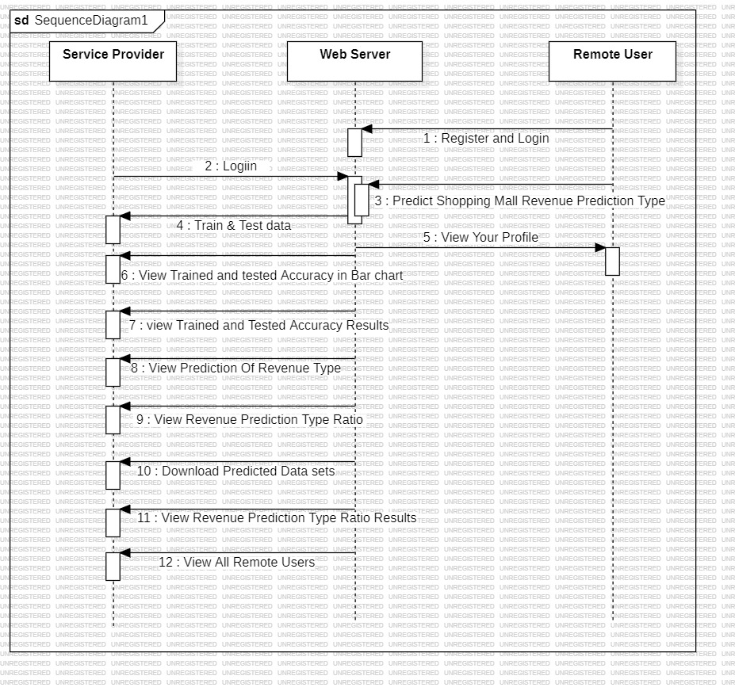
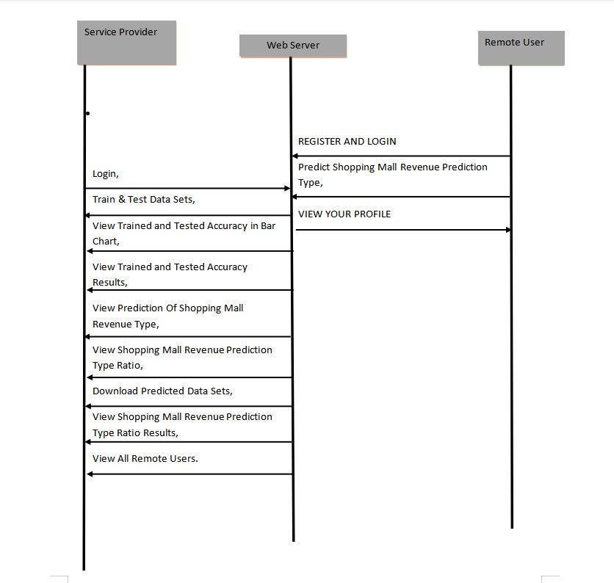
Sequence Diagram:

Slide 16
SAMPLE CODE
from django.db.models import Count
from django.db.models import Q
from django.shortcuts import render, redirect, get_object_or_404
import datetime
import openpyxl
import pandas as pd
from sklearn.feature_extraction.text import CountVectorizer
from sklearn.metrics import accuracy_score, confusion_matrix, classification_report
from sklearn.metrics import accuracy_score
from sklearn.tree import DecisionTreeClassifier
from sklearn.ensemble import VotingClassifier
# Create your views here.
from Remote_User.models import ClientRegister_Model,predict_revenue,detection_ratio,detection_accuracy
def login(request):
if request.method == "POST" and 'submit1' in request.POST:
username = request.POST.get('username')
password = request.POST.get('password')
try:
enter = ClientRegister_Model.objects.get(username=username,password=password)
request.session["userid"] = enter.id
return redirect('ViewYourProfile')

Slide 17
except:
pass
return render(request,'RUser/login.html')
def Add_DataSet_Details(request):
return render(request, 'RUser/Add_DataSet_Details.html', {"excel_data": ''})
def Register1(request):
if request.method == "POST":
username = request.POST.get('username')
email = request.POST.get('email')
password = request.POST.get('password')
phoneno = request.POST.get('phoneno')
country = request.POST.get('country')
state = request.POST.get('state')
city = request.POST.get('city')
ClientRegister_Model.objects.create(username=username, email=email, password=password, phoneno=phoneno,
country=country, state=state, city=city)
return render(request, 'RUser/Register1.html')
else:
return render(request,'RUser/Register1.html')
def ViewYourProfile(request):
userid = request.session['userid']
obj = ClientRegister_Model.objects.get(id= userid)
return render(request,'RUser/ViewYourProfile.html',{'object':obj})

Slide 18
def Predict_Revenue_Type(request):
if request.method == "POST":
if request.method == "POST":
Tid= request.POST.get('Tid')
coupon_no= request.POST.get('coupon_no')
customer_id= request.POST.get('customer_id')
gender= request.POST.get('gender')
age= request.POST.get('age')
category= request.POST.get('category')
quantity= request.POST.get('quantity')
price= request.POST.get('price')
payment_method= request.POST.get('payment_method')
invoice_date= request.POST.get('invoice_date')
shopping_mall= request.POST.get('shopping_mall')
dataset = pd.read_csv("datasets.csv", encoding='latin-1')
def apply_results(label):
if (label == 0):
return 0 # Low
elif (label == 1):
return 1 # High
dataset['Results'] = dataset['Label'].apply(apply_results)
x = dataset['Tid']
y = dataset['Results']

Slide 19
print(x)
print("Y")
print(y)
cv = CountVectorizer(lowercase=False, strip_accents='unicode', ngram_range=(1, 1))
x = cv.fit_transform(x)
models = []
from sklearn.model_selection import train_test_split
X_train, X_test, y_train, y_test = train_test_split(x, y, test_size=0.20)
X_train.shape, X_test.shape, y_train.shape
print("Recurrent Neural Network-RNN")
from sklearn.neural_network import MLPClassifier
mlpc = MLPClassifier().fit(X_train, y_train)
y_pred = mlpc.predict(X_test)
testscore_mlpc = accuracy_score(y_test, y_pred)
accuracy_score(y_test, y_pred)
print(accuracy_score(y_test, y_pred))
print(accuracy_score(y_test, y_pred) * 100)
print("CLASSIFICATION REPORT")
print(classification_report(y_test, y_pred))
print("CONFUSION MATRIX")
print(confusion_matrix(y_test, y_pred))
models.append(('MLPClassifier', mlpc))

Slide 20
# SVM Model
print("SVM")
from sklearn import svm
lin_clf = svm.LinearSVC()
lin_clf.fit(X_train, y_train)
predict_svm = lin_clf.predict(X_test)
svm_acc = accuracy_score(y_test, predict_svm) * 100
print(svm_acc)
print("CLASSIFICATION REPORT")
print(classification_report(y_test, predict_svm))
print("CONFUSION MATRIX")
print(confusion_matrix(y_test, predict_svm))
models.append(('svm', lin_clf))
print("Logistic Regression")
from sklearn.linear_model import LogisticRegression
reg = LogisticRegression(random_state=0, solver='lbfgs').fit(X_train, y_train)
y_pred = reg.predict(X_test)
print("ACCURACY")
print(accuracy_score(y_test, y_pred) * 100)
print("CLASSIFICATION REPORT")
print(classification_report(y_test, y_pred))
print("CONFUSION MATRIX")
print(confusion_matrix(y_test, y_pred))
models.append(('logistic', reg))

Slide 21
print("Decision Tree Classifier")
dtc = DecisionTreeClassifier()
dtc.fit(X_train, y_train)
dtcpredict = dtc.predict(X_test)
print("ACCURACY")
print(accuracy_score(y_test, dtcpredict) * 100)
print("CLASSIFICATION REPORT")
print(classification_report(y_test, dtcpredict))
print("CONFUSION MATRIX")
print(confusion_matrix(y_test, dtcpredict))
classifier = VotingClassifier(models)
classifier.fit(X_train, y_train)
y_pred = classifier.predict(X_test)
Tid1 = [Tid]
vector1 = cv.transform(Tid1).toarray()
predict_text = classifier.predict(vector1)
pred = str(predict_text).replace("[", "")
pred1 = pred.replace("]", "")
prediction = int(pred1)
if prediction == 0:
val = 'Low'
elif prediction == 1:
val = 'High’

Slide 22
print(val)
print(pred1)
predict_revenue.objects.create(
Tid=Tid,
coupon_no=coupon_no,
customer_id=customer_id,
gender=gender,
age=age,
category=category,
quantity=quantity,
price=price,
payment_method=payment_method,
invoice_date=invoice_date,
shopping_mall=shopping_mall,
Prediction=val)
return render(request, 'RUser/Predict_Revenue_Type.html',{'objs': val})
return render(request, 'RUser/Predict_Revenue_Type.html')

Slide 23
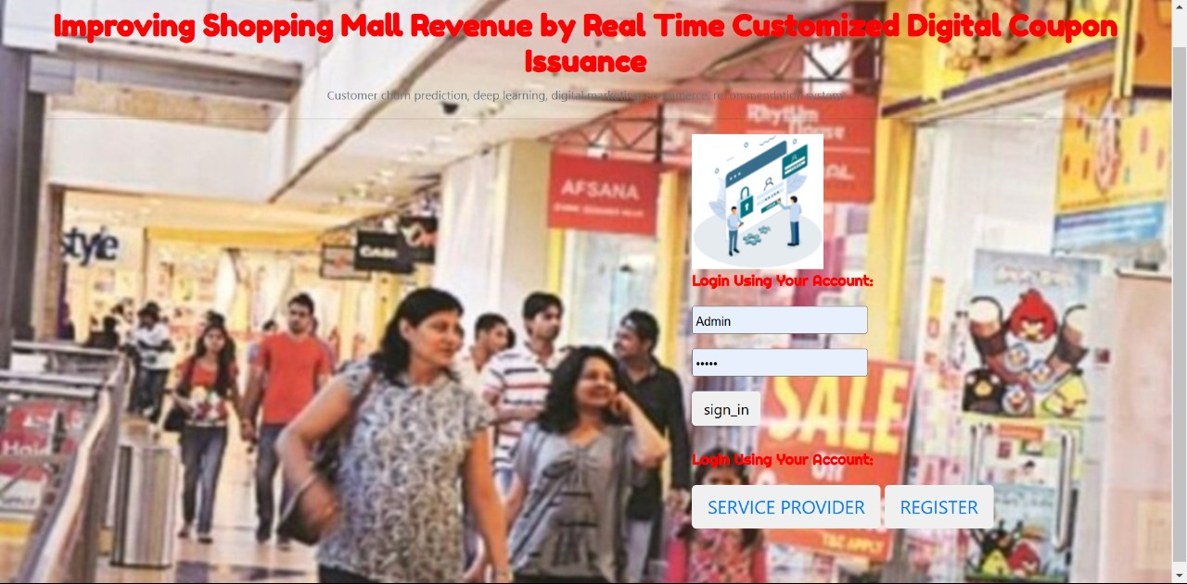
RESULTS:

Slide 24
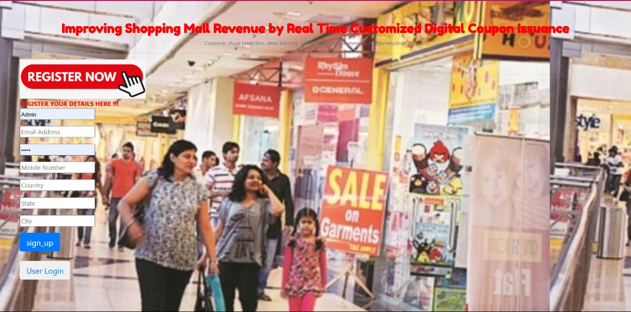

Slide 25
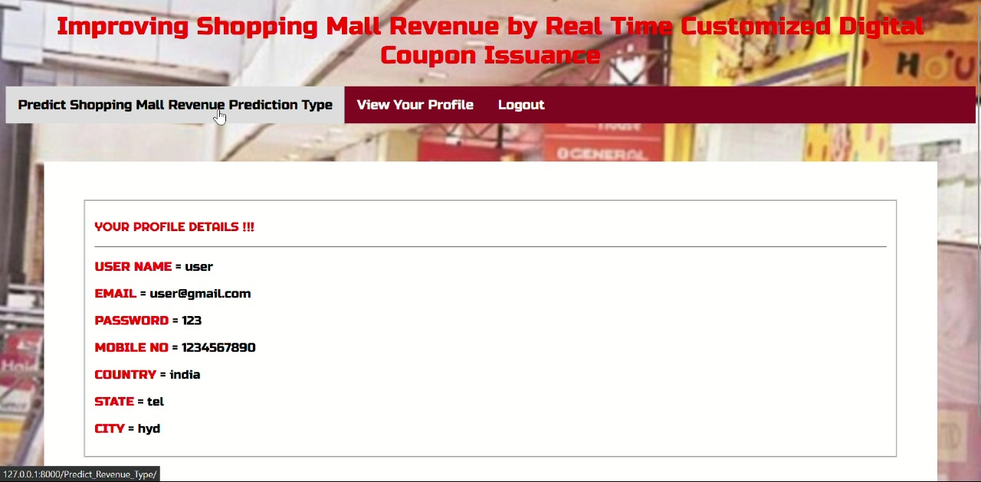

Slide 26
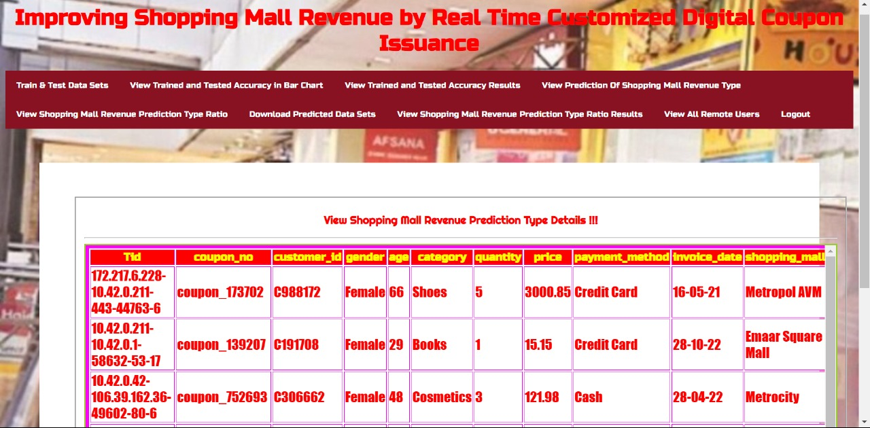

Slide 27
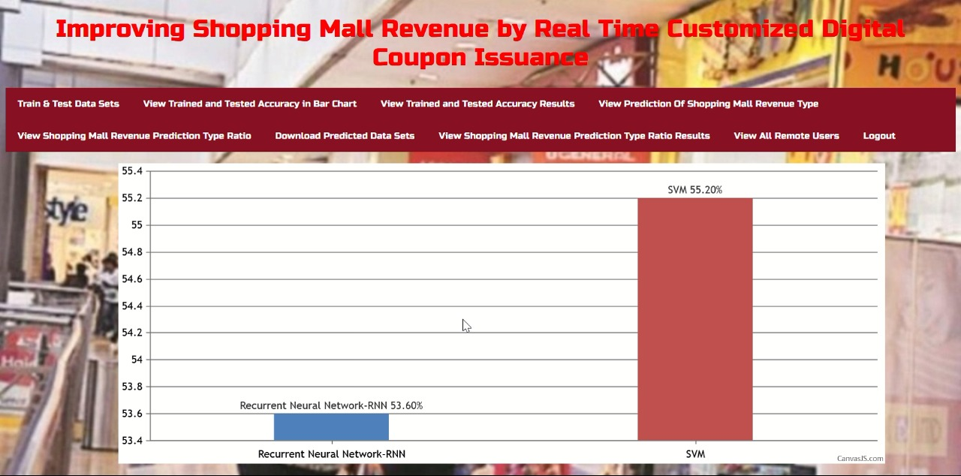

Slide 28
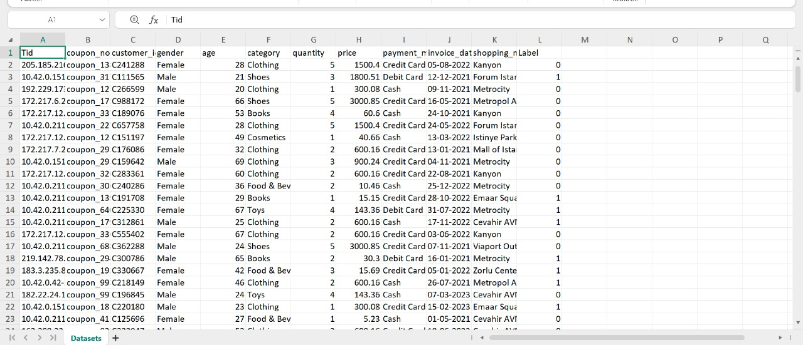

Slide 29
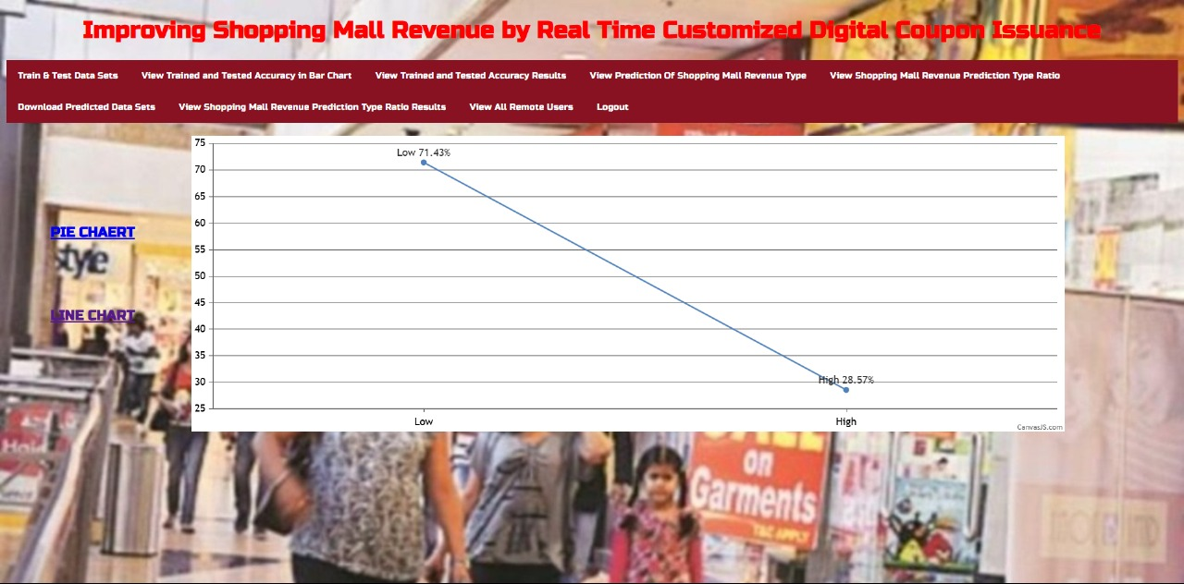

Slide 30
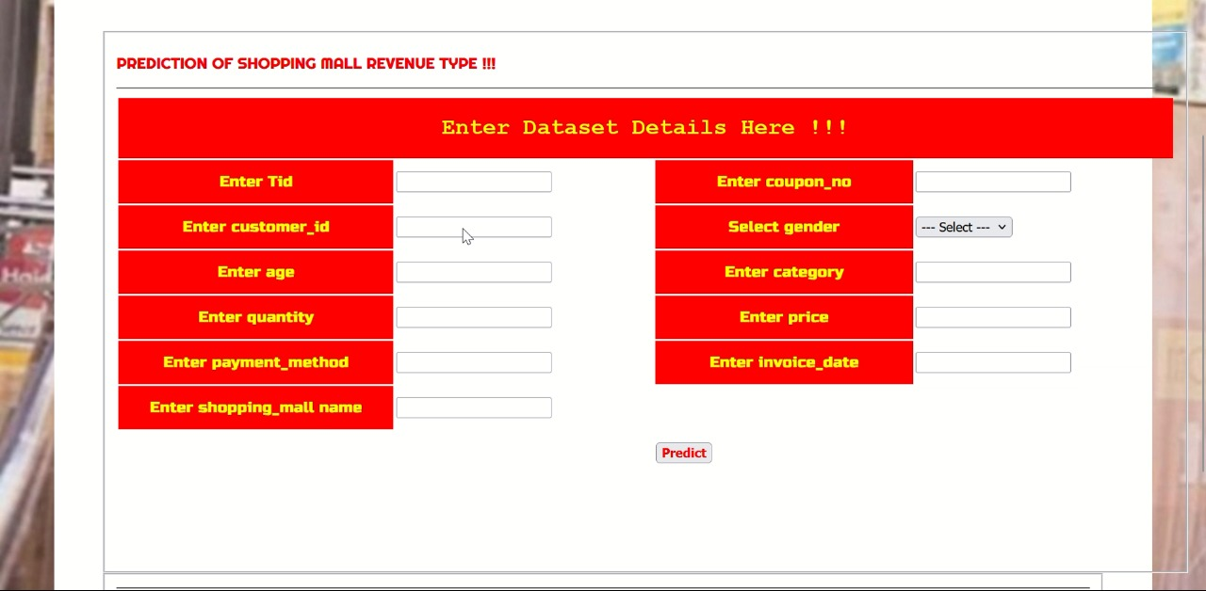

Slide 31
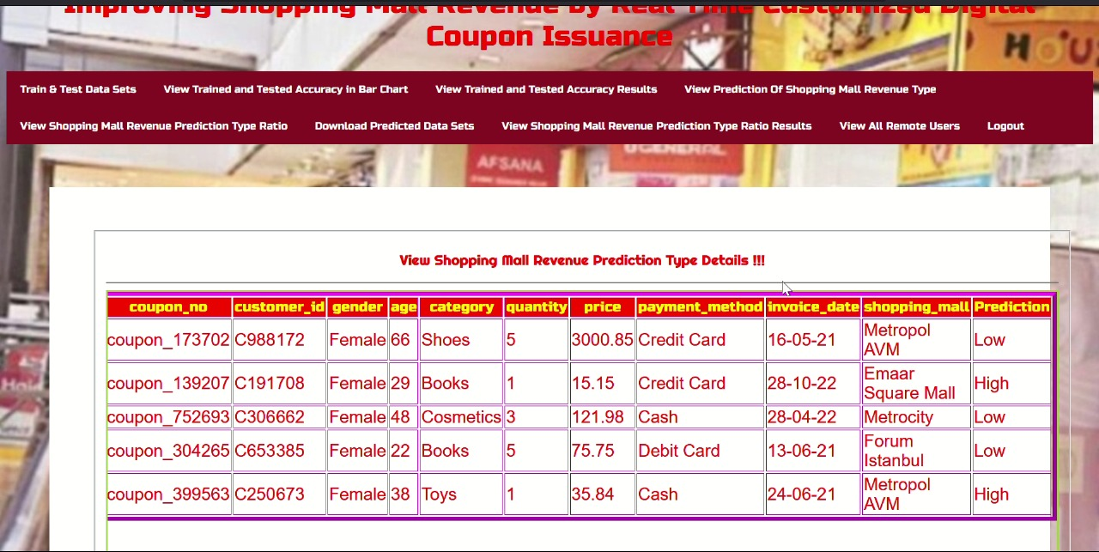

Slide 32
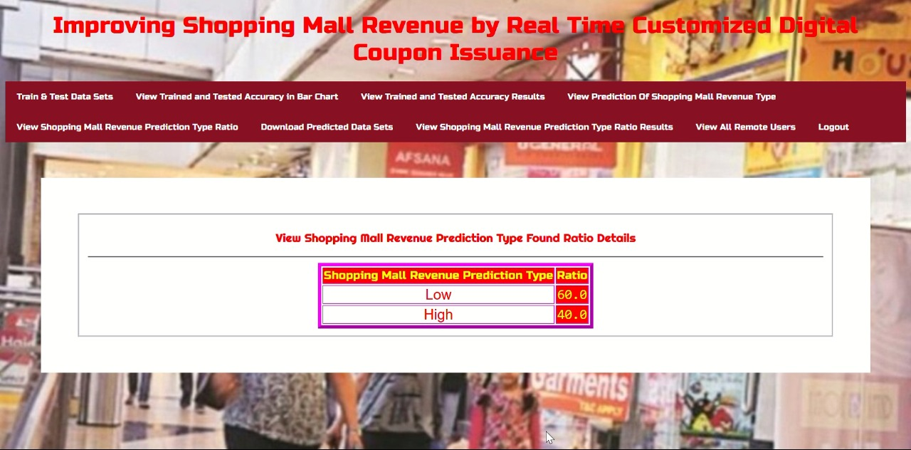

Slide 33
CONCLUSION
By providing shoppers with tailored offers based on their preferences, purchase history, and real-time behavior, this system not only enhances the shopping experience but also increases foot traffic, boosts sales, and improves customer loyalty.
This approach transforms traditional marketing into an agile, data-driven strategy that can drive consistent growth and improve customer satisfaction for shopping malls.

Slide 34
FUTURE SCOPE:
AI-Driven Personalization – Enhance coupon customization using advanced AI and machine learning algorithms to predict customer preferences more accurately.
Integration with IoT and Smart Devices – Utilize IoT-enabled beacons and smart sensors to deliver real-time location-based offers to shoppers inside malls.
Blockchain for Secure Transactions – Implement blockchain technology to ensure secure, transparent, and tamper-proof digital coupon transactions.

Slide 35
REFERENCES
SRIVALLIDEVI, VADDI, and Shaik Rehana. "IMPROVING SHOPPING MALL REVENUE BY REAL TIME CUSTOMIZED DIGITAL COUPON ISSUANCE." International Journal of Engineering Research and Science & Technology 20, no. 2 (2024): 651-663.
Seo, Daeho, and Yongmin Yoo. "Improving shopping mall revenue by real-time customized digital coupon issuance." IEEE Access 11 (2023): 7924-7932.

Slide 36
BHARATHKUMAR, MR, GURRALA VENKATESH, D. RAGHAVA, CH SHANMUKHASAI, and VADIKARI HARIKRISHNA. "IMPROVING SHOPPING MALL REVENUE BY REAL TIME CUSTOMIZED DIGITAL COUPON ISSUANCE." International Journal of Engineering Research and Science & Technology 20, no. 2 (2024): 733-740.
Seo, Daeho, Soobin Choi, and Yongmin Yoo. "Prevention of Customer Churn Due To Issuance of Real-Time Coupons Based on Deep Learning." (2022).
Li, Li, Xiaotong Li, Wenmin Qi, Yue Zhang, and Wensheng Yang. "Targeted reminders of electronic coupons: using predictive analytics to facilitate coupon marketing." Electronic Commerce Research (2022): 1-30.

Slide 37
GITHUB LINK
https://github.com/Raghuvaran0557/Improving-Shopping-Mall-Revenue-by-Real-Time-Customized-Digital-Coupon-Issuance

